Slide 1
PRESENTATION
ON
BANK APPLICATION
PRESENTED BY
Sirisha NB
Syed Waqeer
Farvej Kulmi
Sujan P

Slide 2
PROBLEM STATEMENT
Keeping track the all activities and their record on paper and error . It is also very efficient and a time consuming process of observing continuous increase in number of client visiting the bank. Recording and maintaining all the client records in databases is easy and less time consuming.

Slide 3
REQUIREMENT
FRONT END
AngularJS
Boot Strap
BACK END
Java
MySQL
Spring boot

Slide 4
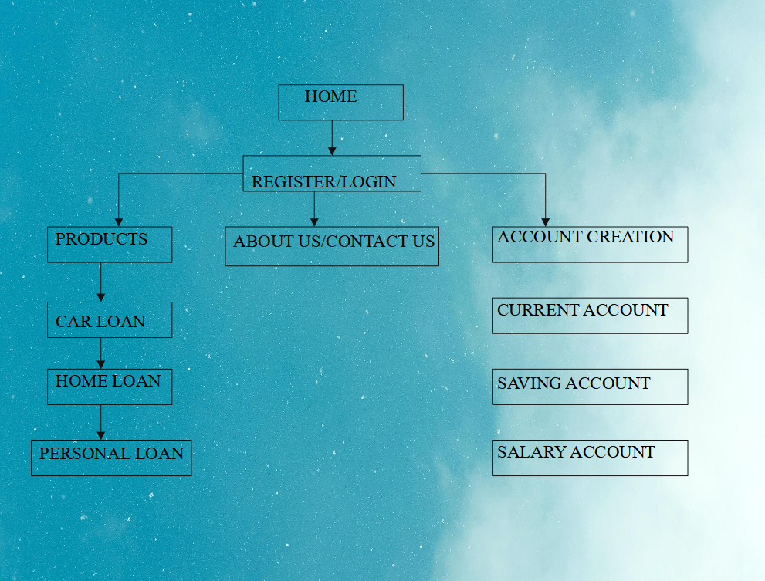
ARCHITECTURE

Slide 5
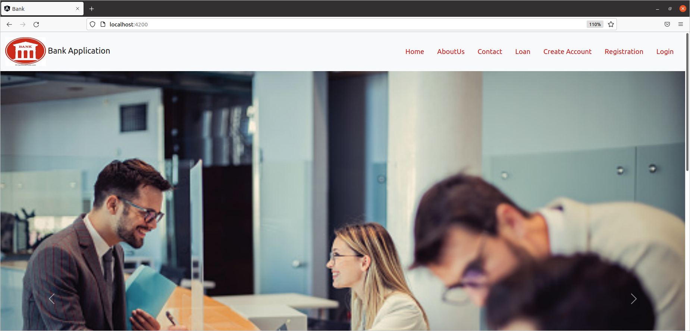
SCREENSHOTS
HOME PAGE

Slide 6
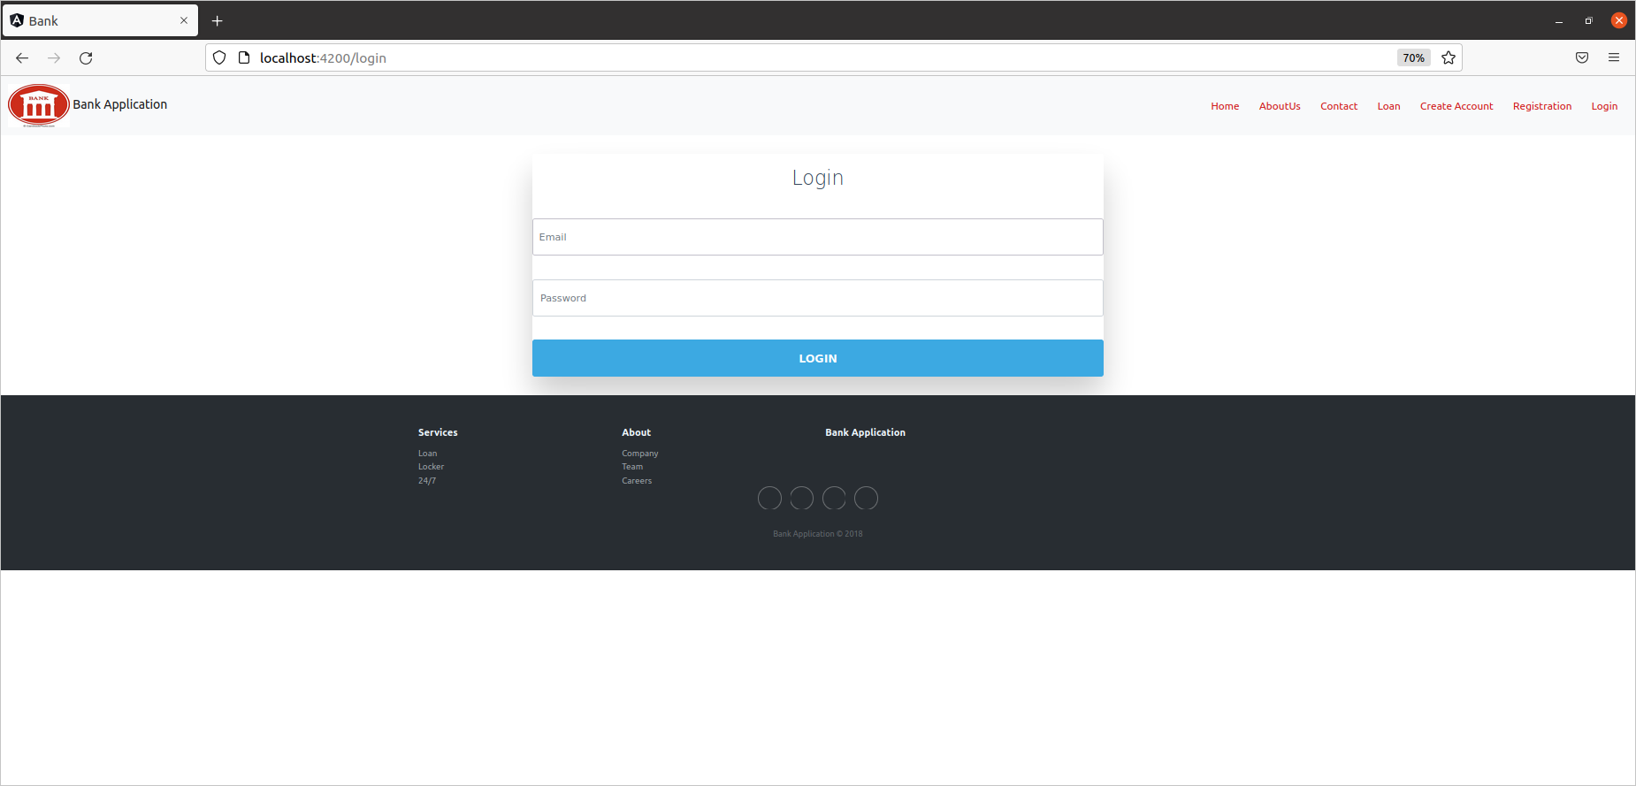
LOGIN PAGE

Slide 7
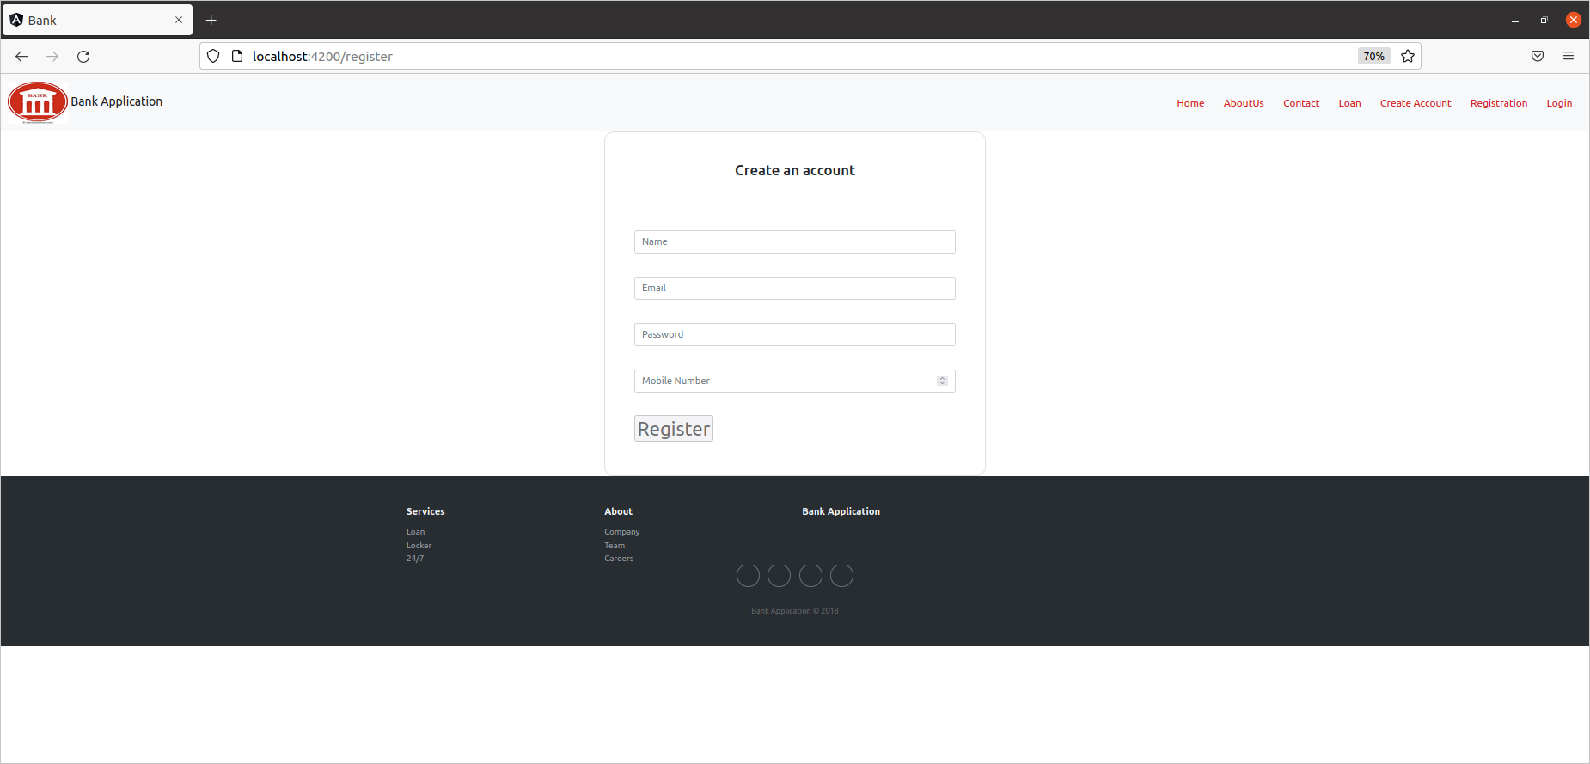
REGISTRATION PAGE

Slide 8
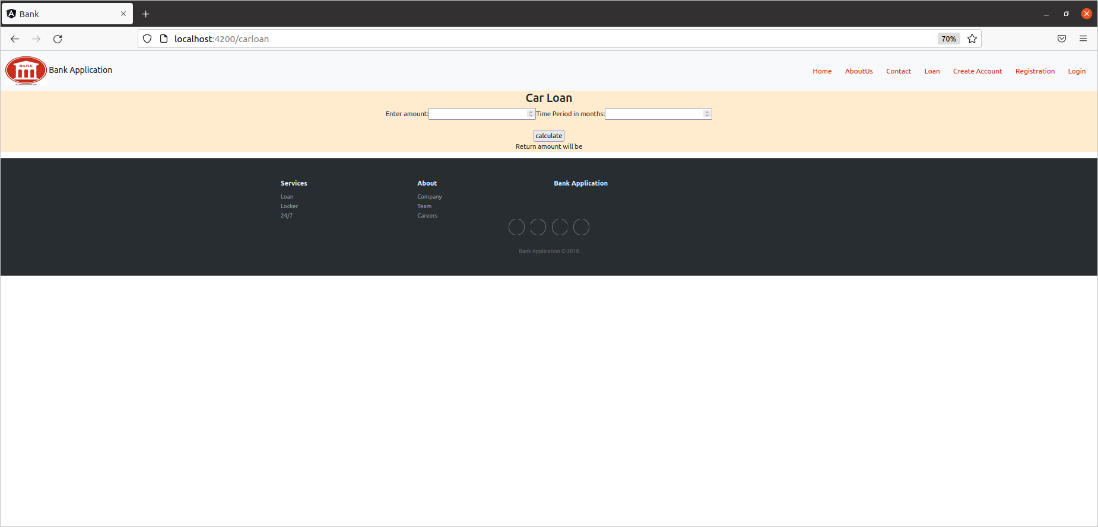
CAR LOAN PAGE

Slide 9
THANK YOU

